Slide 1

មជ្ឈមណ្ឌលកូរ៉េ សហ្វវែរ អេច អ ឌី
Korea Software HRD Center
Java Presentation Materials
ឣ្នកប្រឹក្សាយោបល់: បណ្ឌិត​​ គីម​ ថេខ្យុង
ឣ្នកណែនំា: លោក លាង ប៊ុនរ៉ុង
លោក លន់ សុវត្ថានា
លោក ផេង តុលា
លោក ដារ៉ា ពេញចិត្ត
www.kshrd.com.kh

Slide 2
ថ្នាក់ សៀមរាប
ក្រុមទី ៣​
ប្រធានបទ៖ Java Collection
សមាជិក
លោក ឆៃ​ ជី​វ័ន្ដ​
លោក ណេម​​ សុ​ធា​
លោក ចាន់​ ឧ​ត្ដម​
កញ្ញា ឃួន​ សុវណ្ណ​វត្តី​
លោក​ បូង​​ ចាន់​ណា​រិទ្ធ

Slide 3
មាតិកា
List: 1. Vector 2. ArrayList 3. LinkedList
Set: 4. HashSe 5. TreeSet
Map: 6. TreeMap 7. HashTable

Slide 4
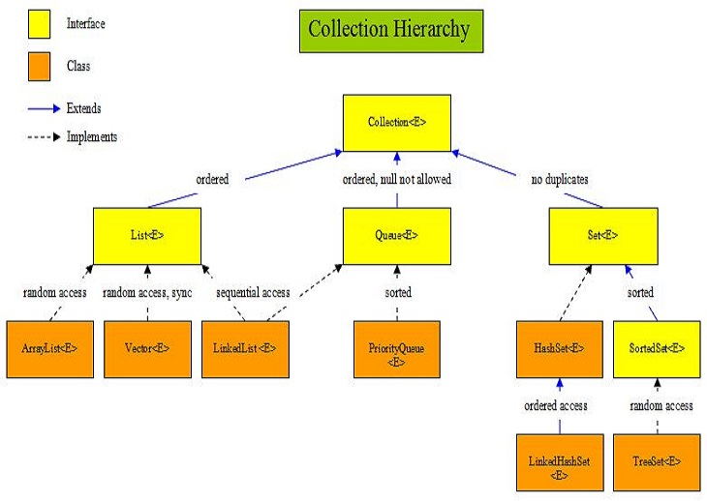
Collection in Java
Collection នៅក្នុង java គឺជា framework ដែលផ្តល់នៅ architecture សម្រាប់ធ្វើការ store និង manipulate group នៃ object ។
Java Collectoin framework ផ្តល់នូវ interface(Set, List, Queue etc...) និង classes(ArrayList, Vector, LinkedList, PriorityQueue, HashSet, LinkedHashSet, TreeSet etc) ជាច្រើន ។
Framework in Java:
ផ្តល់ readymade architecture
តំណាងអោយសំណុំនៃ classes និង interface
is optional
Collection Framwork មាន:
Interfaces and its implementations i.e. classes
Algorithm

Slide 5
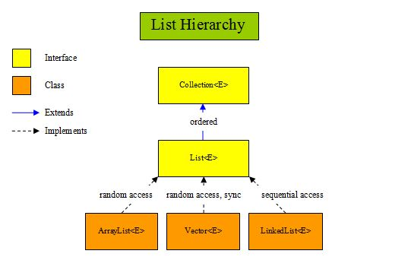
1. Vector
Vector ប្រតិបតិ្តការជាលក្ខណៈ​ dynamic array ហើយវាត្រូវបានបញ្ជាក់ថាមានអត្ថប្រយោជន៍ប្រសិនបើយើងមិនដឹងអំពី​ size របស់​ array ឬ​ យើងត្រូវការប្រភេទមួយដែលអាចធ្វើការផ្លាស់ប្តូរ​ size បានពេញមួយ​ lifetime របស់ program ។
លក្ខណៈសម្បត្តិរបស់ Vector:
Resizable array or grow able array
អនុញ្ញាតអោយមាន duplicate object
Insertion order is preserved
អាច insert ‘null’
អនុញ្ញាតអោយមាន​​ object ដែលជាប្រភេទផ្សេងគ្នា
Vector class បាន implement ពី serializable, cloneable, និង​ RandomAccess interface
Method ភាគច្រើនរបស់ vector គឺត្រូវបាន synchronize ដូចនេះ vector គឺ Thread-safe

Slide 6
1. Vector
Constructor និង​ របៀបក្នុងការបង្កើត vector:
Vector( ): constructor នេះធ្វើការបង្កើត​ default vector ជាមួយនឹងតម្លៃដើមធំបំផុតគឺ 10
Syntax: Vector v = new Vector();
Vector(int size): constructor នេះ accept argument ដែល equal ទៅនឹង size ដែលត្រូវការ​ ហើយបង្កើត​ vector ដែល capacity របស់វាគឺត្រូវបានកំណត់ដោយ​ size
Syntax: Vector v = new Vector(ìnt size);
Vector(int size, int incr): constructor នេះបង្កើត vector ដែលតម្លៃដើមនៃ capacity របស់វាគឺត្រូវបានកំណត់ដោយ size ហើយកំណើននៃ capacity របស់វាកំណត់ដោយ incr(The increment specifies the number of elements to allocate each time that a vector is resized upward)
Syntax: Vector v = new Vector(int size, int incr);
Vector(Collection c): បង្កើត vector ដែលផ្ទុក element របស់ collection c
Syntax: Vector v = new Vector(Collection c);

Slide 7
1. Vector
Method សំខាន់ៗ​របស់ vector class:
void addElement(Object element): It inserts the element at the end of the Vector.
int capacity(): This method returns the current capacity of the vector.
int size(): It returns the current size of the vector.
void setSize(int size): It changes the existing size with the specified size.
boolean contains(Object element): This method checks whether the specified element is present in the Vector. If the element is been found it returns true else false.
boolean containsAll(Collection c): It returns true if all the elements of collection c are present in the Vector.
Object elementAt(int index): It returns the element present at the specified location in Vector.
Object firstElement(): It is used for getting the first element of the vector.
Object lastElement(): Returns the last element of the array.
Object get(int index): Returns the element at the specified index.
boolean isEmpty(): This method returns true if Vector doesn’t have any element.
boolean removeElement(Object element): Removes the specifed element from vector.
boolean removeAll(Collection c): It Removes all those elements from vector which are present in the Collection c.
void setElementAt(Object element, int index): It updates the element of specifed index with the given element.

Slide 8
2. ArrayList
ArrayList ជាClass ដែល​Extend ពី AbstractList និង​ Implement ពី List interface (Cloneable, serialiable, RandomAccess)មានលក្ខណះពិសេស functionality and flexibility ជា Dynamix ដែលអាចអោយយើងអាចពង្រីកនិងពង្រួមទិន្នន័យបាន។
ArrayList បង្កើតឡើងដោយមានការកំណត់ទំហំ តែនៅពេលយើងបញ្ចូលតំលៃលើសពេលនោះ ArrayList ធ្វើការពង្រីកទំហំដោយស្វ័យប្រវត្តិ និង នៅពេលបាត់បង់ពេលនោះArrayList បានពង្រូមទំហំវិញ។
ArrayList Contructorមាន​៣​ប្រភេទ
ArrayList( ) //Empty Contructor
ArrayList(Collection c) // Contructor is Element initialized Collection
ArrayList(int capacity)// specified initial capacity

Slide 9
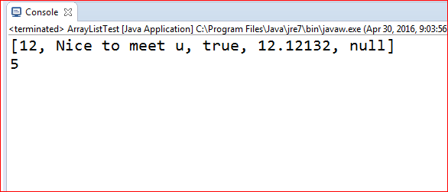
2. ArrayList (Empty Contructor)
public class ArrayListTest {
public static void main(String[] args) {
ArrayList firstContructor = new ArrayList(); // Empty constructor
firstContructor.add(12);
firstContructor.add("Nice to meet u");
firstContructor.add(true);
firstContructor.add(12.12132);
firstContructor.add(null);
System.out.println(firstContructor);
System.out.println(firstContructor.size());
}
}
សំគាល់ : Add ជា Object.

Slide 10
2. ArrayList (ArrayList(Collection c) )
public class ArrayListTest {
public static void main(String[] args) {
ArrayList<String> secondContructor = new ArrayList<>(); // Empty constructor
secondContructor.add("Class Phnom Penh");
secondContructor.add("Class Seim Ream");
secondContructor.add(1, "Class Add index 1"); // add index 1
System.out.println(secondContructor);
System.out.println(secondContructor.size());
secondContructor.remove(1);
System.out.println(secondContructor);
System.out.println(secondContructor.size());
//secondContructor.add(12); // error add String only

Slide 11
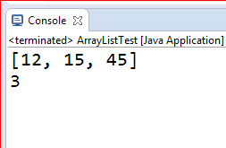
2. ArrayList (ArrayList() )
Arraylist (int capacity) ហេតុអ្វីinitializedពីព្រោះតែយើងត្រូវកំណត់ប្រសិទ្ធិភាពក្នុងការកំណត់Capacity ElementនៅពេលយើងAdd Element New វានិង​Copy to New Location in Memory ពេលនោះវាClear Location Old Location ប្រសិនបើយើងមិនកំណត់Capacityវានិងធ្វើការRepeated Reallocated List in Memory Add Auto នោះវាកើនLocation in Memory auto;
Note: Capacity មិនមែនជាSize ទេ
public class ArrayListTest {
public static void main(String[] args) {
ArrayList<Integer> thirdContructor = new ArrayList<>(2);//
thirdContructor.add(12);
thirdContructor.add(15); // reserve filled
thirdContructor.add(45);
System.out.println(thirdContructor);
System.out.println(thirdContructor.size());

Slide 12
2. ArrayList
Method សំខាន់ៗ
add(int index, Object element) // add index and element of list
add(Object o) // add object
addAll(Collection c) // we have 2 list . Add one list to other one list
addAll(int index, Collection c) // add
void clear()​​ //Removes all of the elements from this list.
size() // how size of list
remove(int index) // remove index

Slide 13
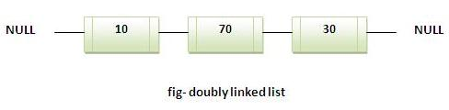
3. LinkedList
LinkedList class extends ពី AbstractSequentialList និង implements List interface. វា​ផ្តល់នូវ linked-list data structure.
លក្ខណៈសម្បត្តិរបស់ LinkedList:
Java LinkedList class ប្រើ doubly linked list សម្រាប់ធ្វើការ store រាល់​ elements
Java LinkedList class អាចផ្ទុក​ duplicate elements
Java LinkedList class រក្សានូវ insertion order
Java LinkedList class គឺ non synchronized
Manipulation មានលក្ខណៈលឿនពីព្រោះមិនចាប់បាច់មាន shifting operation នៅពេល​ add ឬ remove element
Java LinkedList class អាចត្រូវបានប្រើដូចជា list, stack ឬ queue

Slide 14
3. LinkedList
Constructor និង​ របៀបក្នុងការបង្កើត LinkedList:
LinkedList( ): constructor​ នេះបង្កើត empty linked list
Syntax: LinkedList l = new LinkedList();
LnkedList(Collection c): This constructor បង្កើត linked list ដែលត្រូវបាន initialize ជាមួយនឹង elements របស់ collection c
Syntax: LinkedList l = new LinkedList(Collection c);
Method របស់ LinkedList:
SN | Methods with Description
1 | void add(int index, Object element)Inserts the specified element at the specified position index in this list. Throws IndexOutOfBoundsException if the specified index is is out of range (index < 0 || index > size()).
2 | boolean add(Object o)Appends the specified element to the end of this list.
3 | boolean addAll(Collection c)Appends all of the elements in the specified collection to the end of this list, in the order that they are returned by the specified collection's iterator. Throws NullPointerException if the specified collection is null
4 | boolean addAll(int index, Collection c)Inserts all of the elements in the specified collection into this list, starting at the specified position. Throws NullPointerException if the specified collection is null.
5 | void addFirst(Object o)Inserts the given element at the beginning of this list.
6 | void addLast(Object o)Appends the given element to the end of this list.
7 | void clear()Removes all of the elements from this list.
8 | Object clone()Returns a shallow copy of this LinkedList.
9 | boolean contains(Object o)Returns true if this list contains the specified element. More formally, returns true if and only if this list contains at least one element e such that (o==null ? e==null : o.equals(e)).
10 | Object get(int index)Returns the element at the specified position in this list. Throws IndexOutOfBoundsException if the specified index is is out of range (index < 0 || index >= size()).
11 | Object getFirst()Returns the first element in this list. Throws NoSuchElementException if this list is empty.
12 | Object getLast()Returns the last element in this list. Throws NoSuchElementException if this list is empty.
13 | int indexOf(Object o)Returns the index in this list of the first occurrence of the specified element, or -1 if the List does not contain this element.

Slide 15
3. LinkedList
14 | int lastIndexOf(Object o)Returns the index in this list of the last occurrence of the specified element, or -1 if the list does not contain this element.
15 | ListIterator listIterator(int index)Returns a list-iterator of the elements in this list (in proper sequence), starting at the specified position in the list. Throws IndexOutOfBoundsException if the specified index is is out of range (index < 0 || index >= size()).
16 | Object remove(int index)Removes the element at the specified position in this list. Throws NoSuchElementException if this list is empty.
17 | boolean remove(Object o)Removes the first occurrence of the specified element in this list. Throws NoSuchElementException if this list is empty. Throws IndexOutOfBoundsException if the specified index is is out of range (index < 0 || index >= size()).
18 | Object removeFirst()Removes and returns the first element from this list. Throws NoSuchElementException if this list is empty.
19 | Object removeLast()Removes and returns the last element from this list. Throws NoSuchElementException if this list is empty.
20 | Object set(int index, Object element)Replaces the element at the specified position in this list with the specified element. Throws IndexOutOfBoundsException if the specified index is is out of range (index < 0 || index >= size()).
21 | int size()Returns the number of elements in this list.
22 | Object[] toArray()Returns an array containing all of the elements in this list in the correct order. Throws NullPointerException if the specified array is null.
23 | Object[] toArray(Object[] a)Returns an array containing all of the elements in this list in the correct order; the runtime type of the returned array is that of the specified array.

Slide 16
Set
A Set is a Collection that cannot contain duplicate element.
The Set Interface contain only method inherited from Collection and adds the restriction that duplicate elements are prohibited
Methods | Description
Add() | Adds an object to the collection
clear( ) | Removes all objects from the collection
contains( ) | Returns true if a specified object is an element within the collection
isEmpty( ) | Returns true if the collection has no elements
iterator( ) | Returns an Iterator object for the collection which may be used to retrieve an object
remove( ) | Removes a specified object from the collection
size( ) | Returns the number of elements in the collection

Slide 17
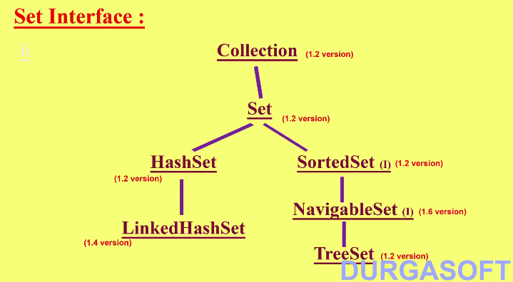
4. HashSet
Set
Set​ គឺជា child interface របស់ collection
បើសិនបែងចែក ក្រុមនៃ Objects និង អ្នកមិនចង់មាន Duplicates ហើយមិនមានការបញ្ចូលតម្លៃបំរុង អ្នកគួរប្រើប្រាស់ Set
Set interface មិនផ្ទុកនូវmethod ថ្មី។ ដូចនេះគួរប្រើប្រាស់ Collection interface method

Slide 18
4. HashSet
ការស្វែងយល់ពី data structure គឺ Hastable ( contructor)
មិនអនុញ្ញាត មានតម្លៃ duplicates បើសិនជាយើងព្យាយាម​បញ្ចួលតម្លៃស្ទួន។ វានឹងមិនទទួលយកនៅពេល compiletime or runtime error ហើយ method add() និង​ return false
មិនមានតម្លៃបំរុង ហើយរាល់Objects ទាំងអស់នឹងត្រូវបានបញ្ចូលតាមរយៈ hash-code(address memory) នៃ Object។
Objects ផ្សេងគ្នាគឺអនុញ្ញាត។
តម្លៃ Null គឺអាចអនុញ្ញាត។
វា​ Implement ពី​interface ប៉ុន្តែ មិន RedomAccess
HashSet គឺជាជំរើសដ៏ល្អប្រសិនបើអ្នកធ្វើការជាមួយប្រត្តិការSearch

Slide 19
4. HashSet
Constructors | Description
HashSet h=new HashSet( ) | Creates an empty HashSet Object with default initial capacity 16 and default Fill Retio 0.75
HashSet h=new HashSet(Collection c) | For inter conversation between Collections
HashSet h=new HashSet(int capacity) | Create an empty HashSet Object with specified initial capacity & default Fill Retio 0.75
HashSet(int capacity, float fillRatio) | Create an empty HashSet object with specified initial capacity & specified Load Factor(or Fill Ratio)

Slide 20
4. HashSet
Methods | Description
boolean add(Object o) | Adds the specified element to this set if it is not already present.
void clear() | Removes all of the elements from this set.
Object clone() | Returns a shallow copy of this HashSet instance: the elements themselves are not cloned.
boolean contains(Object o) | Returns true if this set contains the specified element
boolean isEmpty() | Returns true if this set contains no elements.
Iterator iterator() | Returns an iterator over the elements in this set.
boolean remove(Object o) | Removes the specified element from this set if it is present.
int size() | Returns the number of elements in this set (its cardinality).

Slide 21
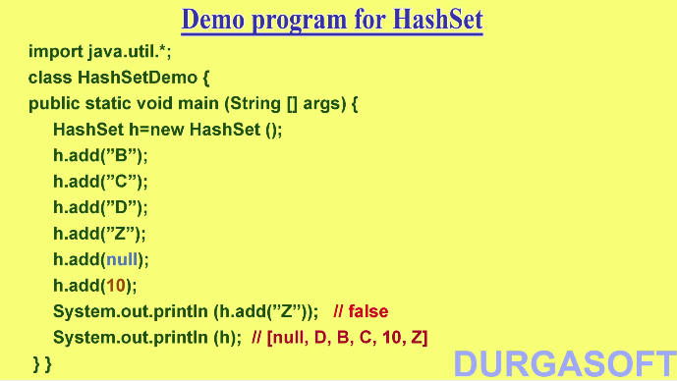
4. HashSet
Example

Slide 22
5. TreeSet
ការស្វែងយល់ពី data structure គឺ BalanceTree
អនុញ្ញាត មានតម្លៃ duplicates។
មិនមានតម្លៃបំរុង ហើយរាល់ Objects ទាំងអស់នឹងត្រូវបានបញ្ចូលតាមរយៈ​ការតំរៀប។
Objects ផ្សេងគ្នាគឺមិនអនុញ្ញាត ប៉ុន្តែ វានឹងទទួលយកនៅពេល runtime​ Exception របស់ ClassCastException។
តម្លៃ Null គឺអាចអនុញ្ញាត ប៉ុន្តែ មួយ។

Slide 23
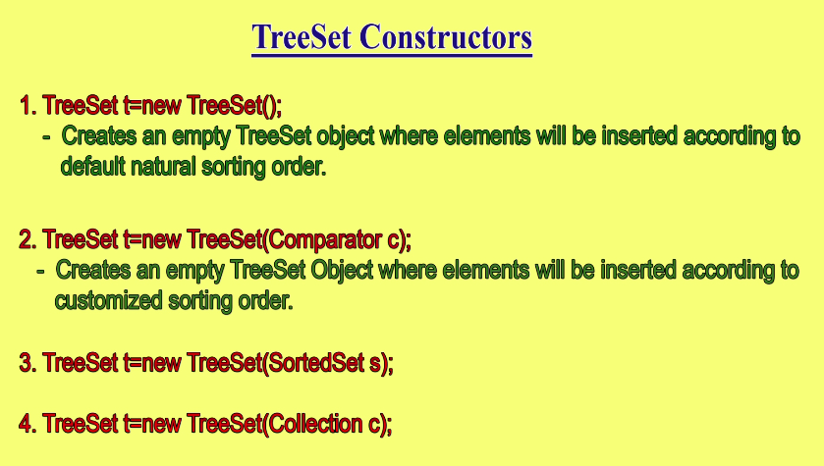
5. TreeSet

Slide 24
5. TreeSet
Method | Description
void add(Object o) | Adds the specified element to this set if it is not already present.
boolean addAll(Collection c) | Adds all of the elements in the specified collection to this set.
void clear() | Removes all of the elements from this set.
Object clone() | Returns a shallow copy of this TreeSet instance.
Comparator comparator() | Returns the comparator used to order this sorted set, or null if this tree set uses its elements natural ordering.
boolean contains(Object o) | Returns true if this set contains the specified element.
Object first() | Returns the first (lowest) element currently in this sorted set.
SortedSet headSet(Object toElement) | Returns a view of the portion of this set whose elements are strictly less than toElement.
boolean isEmpty() | Returns true if this set contains no elements.
Iterator iterator() | Returns an iterator over the elements in this set.
Object last() | Returns the last (highest) element currently in this sorted set.

Slide 25
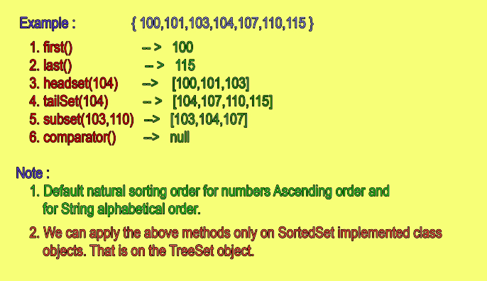
5. TreeSet

Slide 26
Map
The Map interface maps keys to values
A Map Cannot Contain duplicate keys
key is an object that u use to retrieve a value at a later date
Given a key and a value, you can store the value in a Map object. After the value is stored, you can retrieve it by using its key.
Several methods throw:
a NoSuchElementException when no items exist in the invoking map.
A ClassCastException is thrown when an object is incompatible with the elements in a map.
A NullPointerException is thrown if an attempt is made to use a null object and null is not allowed in the map.
An UnsupportedOperationException is thrown when an attempt is made to change an unmodifiable map

Slide 27
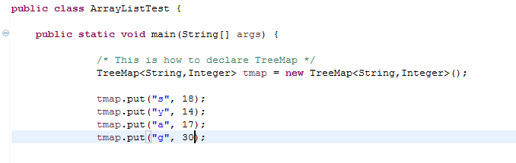

6. TreeMap
Treemap ជា​​ Red-Black tree base on NavigableMap implementation។
វា​ត្រូវ​បាន​ប្រើ​ដើម្បី​ sort ArrayList ហើយ​រៀប​ ArrayList តាម​លំ​ដាប់​នៃ​ Keys របស់​វា​។
​ TreeMap Class implement from Map Interface ដូច​ HashMap ដែរ​។​
តែ​វា​ខុស​គ្នា​ត្រង់​ HashMap ជា​ unordered collection តែ​ TreeMap វិញ​វា​រៀប​ជា​ Order of its keys។​

Slide 28
6. TreeMap
TreeMap Constructors
Constuctors | Description
TreeMap() | This constructor constructs an empty tree map that will be sorted by using the natural order of its keys
TreeMap(Comparator comp) | This constructor constructs an empty tree-based map that will be sorted by using the Comparator comp.
TreeMap(Map m) | This constructor initializes a tree map with the entries from m, which will be sorted by using the natural order of the keys.
TreeMap(SortedMap sm) | This constructor initializes a tree map with the entries from the SortedMap sm, which will be sorted in the same order as sm:

Slide 29
6. TreeMap
void clear()Removes all mappings from this TreeMap.
Object clone() Returns a shallow copy of this TreeMap instance.
Comparator comparator() Returns the comparator used to order this map, or null if this map uses its keys' natural order.
boolean containsKey(Object key) Returns true if this map contains a mapping for the specified key.
boolean containsValue(Object value) Returns true if this map maps one or more keys to the specified value.
Set entrySet() Returns a set view of the mappings contained in this map.
Object firstKey() Returns the first (lowest) key currently in this sorted map.
Object get(Object key)Returns the value to which this map maps the specified key.
SortedMap headMap(Object toKey)Returns a view of the portion of this map whose keys are strictly less than toKey.
Set keySet()Returns a Set view of the keys contained in this map.
Object lastKey()Returns the last (highest) key currently in this sorted map.
Object put(Object key, Object value)Associates the specified value with the specified key in this map.
void putAll(Map map)Copies all of the mappings from the specified map to this map.
Object remove(Object key)Removes the mapping for this key from this TreeMap if present.
int size()Returns the number of key-value mappings in this map.
SortedMap subMap(Object fromKey, Object toKey) Returns a view of the portion of this map whose keys range from fromKey, inclusive, to toKey, exclusive.
SortedMap tailMap(Object fromKey) Returns a view of the portion of this map whose keys are greater than or equal to fromKey.
Collection values()Returns a collection view of the values contained in this map.

Slide 30
7. HashTable
HashTable ជាផ្នែកមួយនៃ java.util ហើយបាន implement ពី ​Map interface និង extend ពី Dictionary class ។
វាមានការ synchronized។
វារក្សាទុកតែធាតុណាដែល unique ប៉ុន្នោះ។
មិនអាចមាន null key ឫ null value។
រក្សាទុក (store) នូវ keyនិង value ជាគូរៗក្នុង table​។
មិនមានការរៀបតាមលំដាប់។
Key បានធ្វើការ hash (accessing to Data item by key) ដើម្បីស្វែងរក index របស់ values ដែលបានផ្ទុកក្នុង table។
Notes:
The keys are unique in all maps
Hash map key is unique. Add duplicate key, then it will be overwrite.

Slide 31
7. HashTable
import java.util.Hashtable;
import java.util.Map.Entry;
public class CollectionHashTable {
public static void main(String[] args) {
Hashtable<Integer,String> ht=new Hashtable<Integer,String>();
ht.put(10,"Veasna");
ht.put(12,"Ravi");
ht.put(11,"Vatey");
ht.put(14,"Rathana");
for(Entry<Integer, String> m:ht.entrySet()){
System.out.println(m.getKey()+" "+m.getValue());
}
}
}
Out Put
10 Veasna
14 Rathana
12 Ravi
11 Vatey

Slide 32
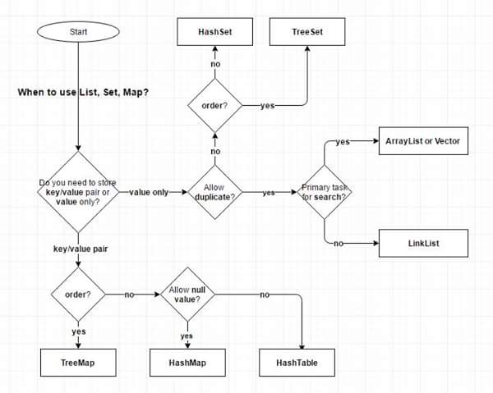
When to use List, Map, Set?

Slide 33
10. ប្រភពឯកសារ
http://www.tutorialspoint.com/java/java_linkedlist_class.htm
http://beginnersbook.com/2013/12/vector-in-java/
https://www.youtube.com/watch?v=ZqDT9xg4TGE&index=19&list=PLd3UqWTnYXOkVR3OR9UZGyEt9RFUbaTZ
http://www.tutorialspoint.com/java/java_hashtable_class.htm
http://www.javatpoint.com/Hashtable-class-in-collection-framework

Slide 34
សូមអរគុណ!!!

